Slide 1





Constrained Mixed-Critical Parallelization for Distributed Heterogeneous Systems
Authors:
Robert Höttger, Mustafa Özcelikörs, Philipp Heisigg,
Lukas Krawczyk, Carsten Wolff, Burkhard Igel
Presentation:
Mustafa Özçelikörs (2nd author)
IDiAL Institute – Dortmund University of Applied Sciences and Arts
Germany
Acknowledgements
The project is funded by BMBF Fund.Nb. 01-S14029K under Project AMALTHEA4public. A4MCAR project is also granted by The Eclipse Foundation and Google Inc. during Google Summer of Code 2017.

Slide 2
Contents
Introduction
Parallel Programming Basics
APP4MC
A4MCAR
Tracing
Modeling
Results

Slide 3
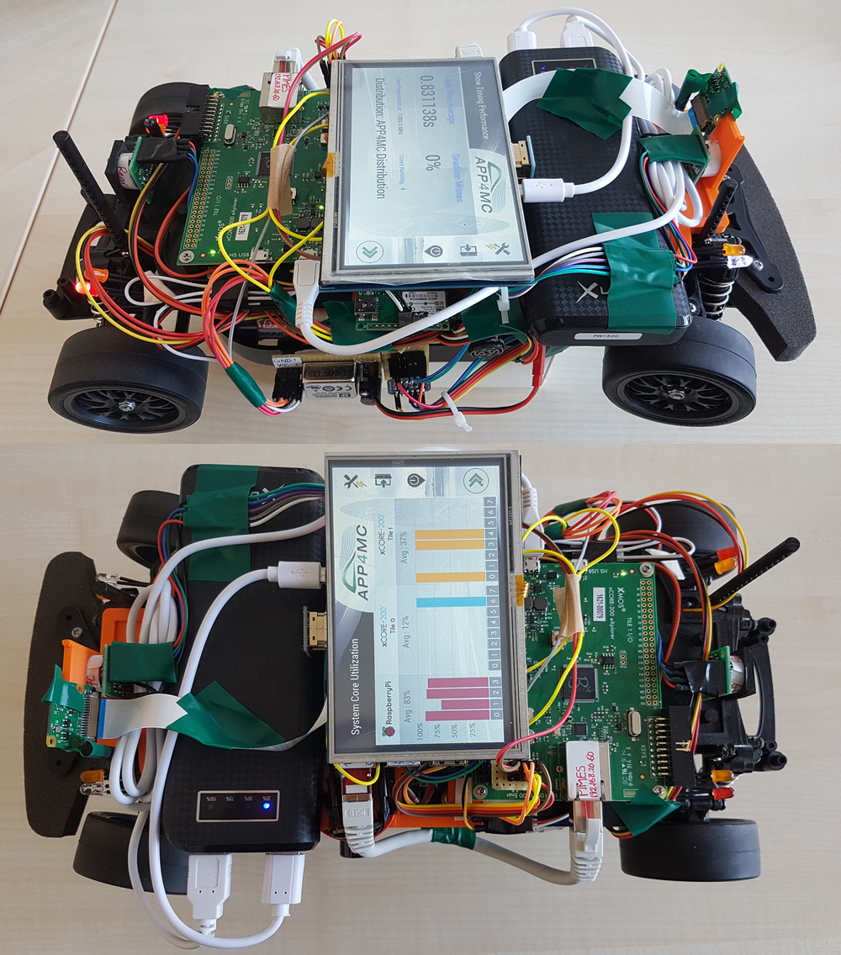
Introduction
Overview
APP4MC
Goal: “Open” model-based embedded multi-core platform
Automotive domain
Sw distribution through Sw and Hw modeling
A4MCAR
Goal: Demonstrator to test, tool support to supply APP4MC
Features schedulable and traceable software
Has many features
Tracing & distribution features involved for GNU/Linux

Slide 4


Introduction
Motivations
Evolution of algorithms, applications, and application domains.
Evolution of new trends in parallel computing
Evolution of multi-core processors
Example platform: AUTOSAR
Model-based development
Developing open-source!!!

Slide 5
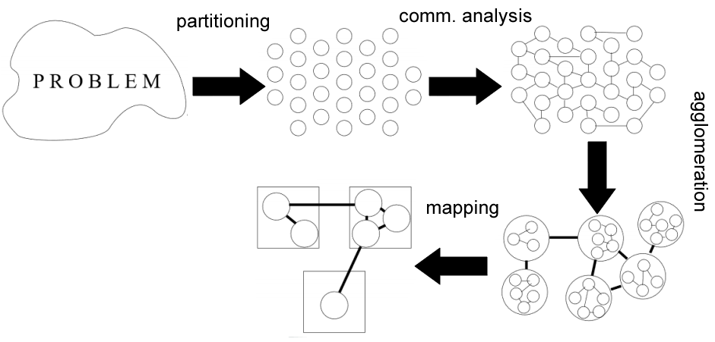
Parallel Programming Basics
Basics
Runnable
Process
Thread
Process vs Thread
Design Techniques

Slide 6
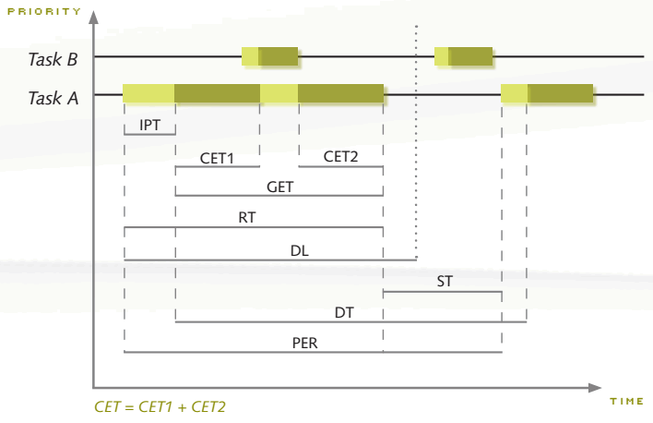
Parallel Programming Basics
Synchronization
Race conditions, deadlock
Mutex
Semaphores
Scheduling Analysis
Interprocess Communication
Shared memory comm.
Mapped memory
Process semaphores
FIFOs
Pipes
Sockets
used
used
for job queues,
used rarely
used
used
ST,
GET,
DL,

Slide 7
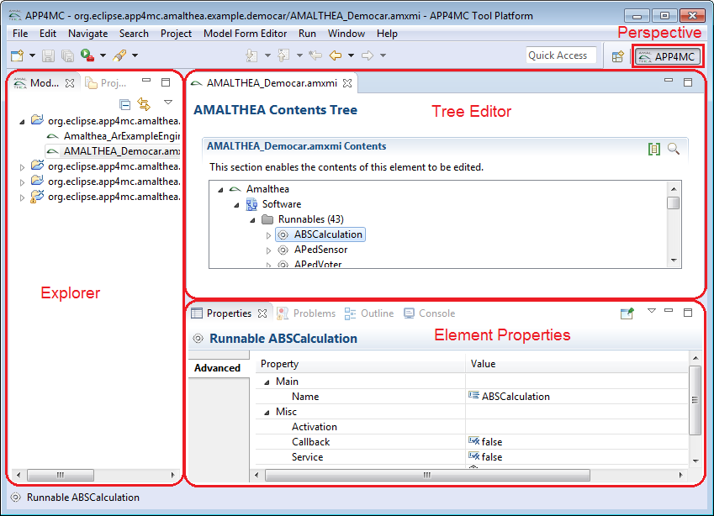
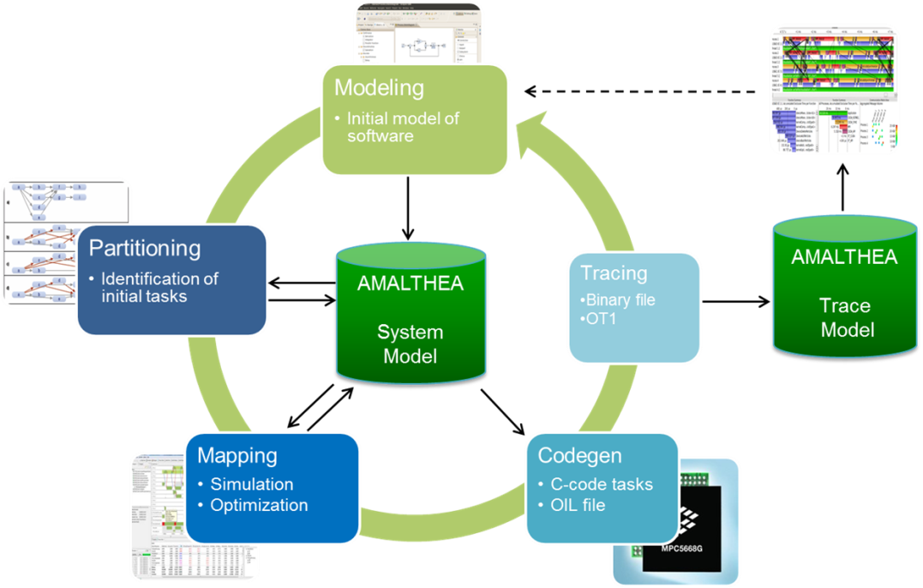
APP4MC
What is APP4MC?
Design Flow with APP4MC
Modeling
AMALTHEA models
Partitioning
ESSP, CPP
Generating Tasks
Mapping
ILP-based, GA-based load balancing
Reducing computation time
Optimization towards energy consumption

Slide 8
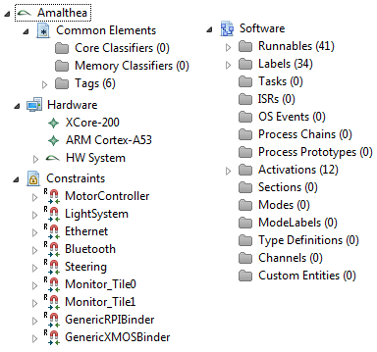
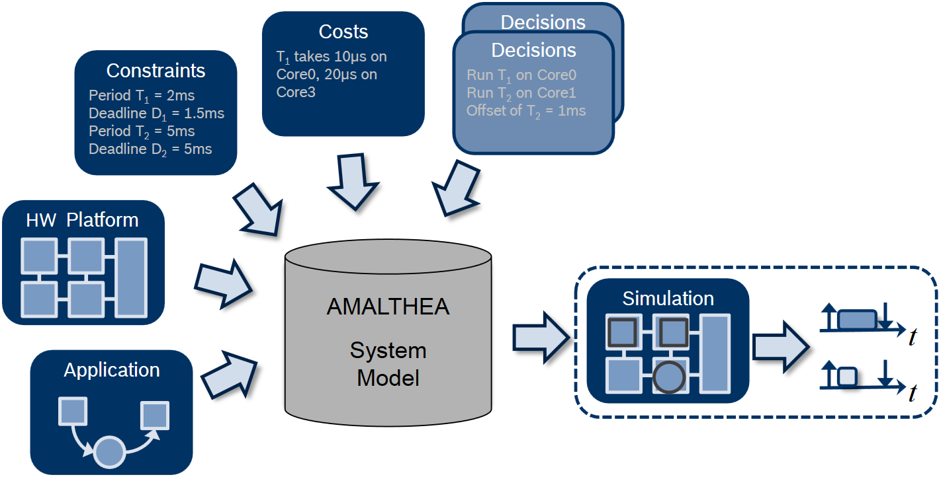
APP4MC
Modeling
XML-based AMALTHEA model

Slide 9
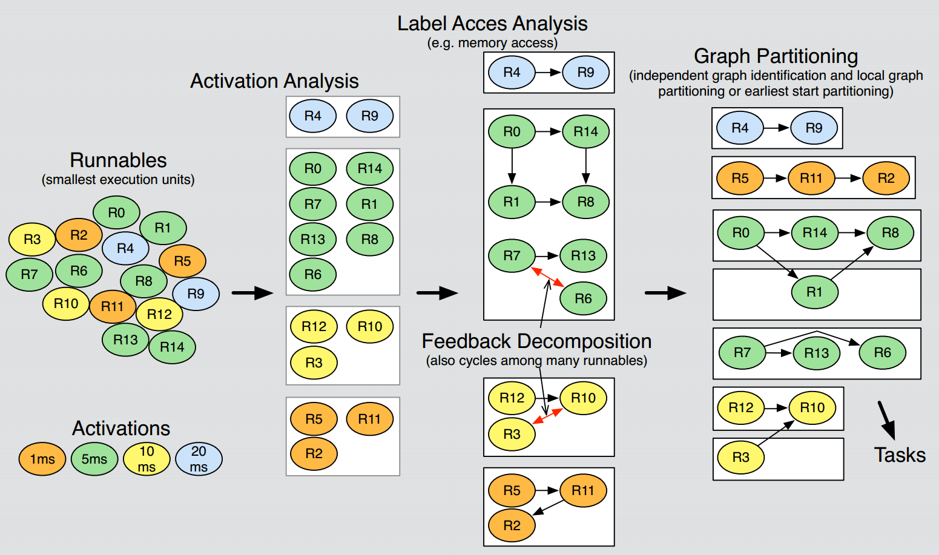
APP4MC
Industrial Use Case of Graph Theory in APP4MC
(image from Robert Höttger, ESM DPS WS 2015/2016, FH Dortmund)

Slide 10
APP4MC
Mapping
Allocation of
Tasks to cores
Data and labels to memory
Options:
ILP-based, GA-based load balancing
Goals:
Reducing computation time (main concern)
Optimization towards energy consumption

Slide 11
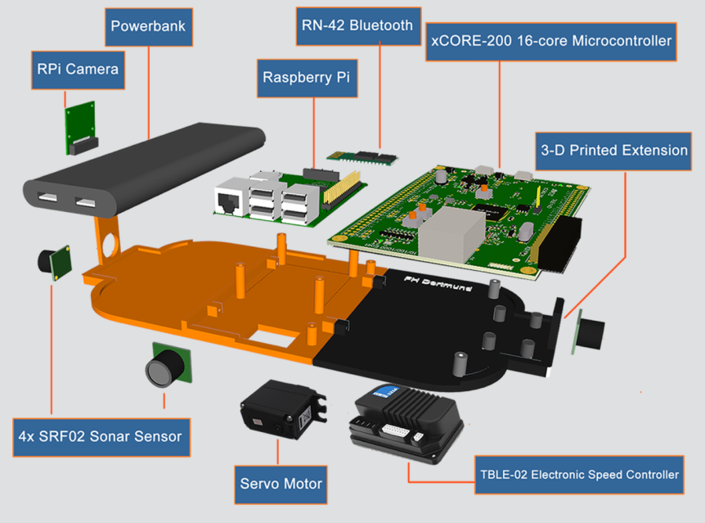
A4MCAR
Introduction
Apps such as:
Android phone/bluetooth control, web interface front-end, Touchscreen display, Sensor applications, Image processing

Slide 12
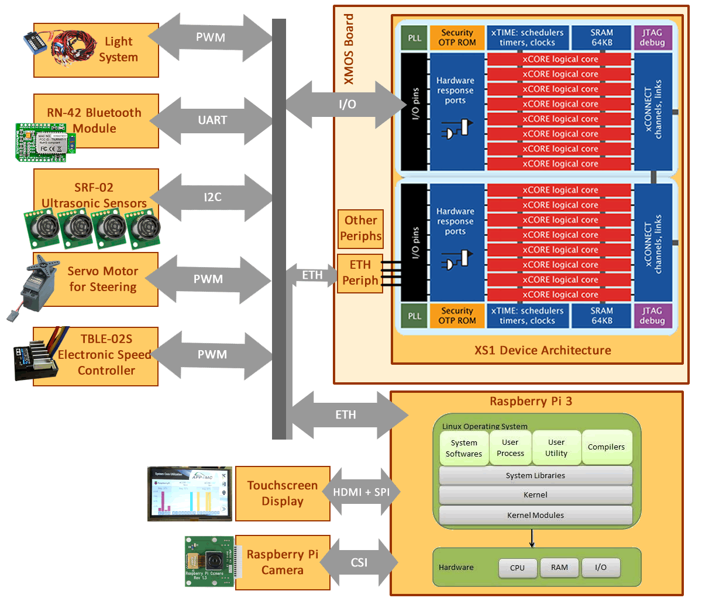
A4MCAR
Overall Look to A4MCAR
Hardware
Low-level Module
XMOS xCORE eXplorerKIT
4x SRF-02 Sonar Sensor
TBLE-02S Speed Controller
Servo Motor for Steering
RN-42 Bluetooth Module
Lighting Module
High-level Module
Raspberry Pi (Raspbian/Linux)
Touchscreen Display (HDMI+SPI)
Rpi Camera

Slide 13
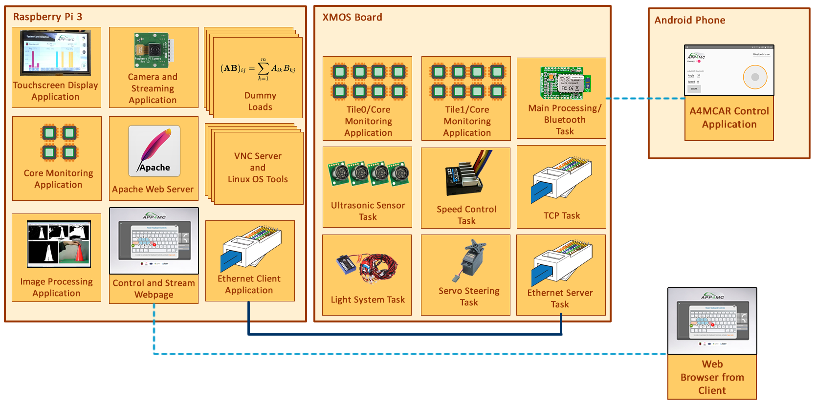
A4MCAR
Overall Look to A4MCAR
Software

Slide 14
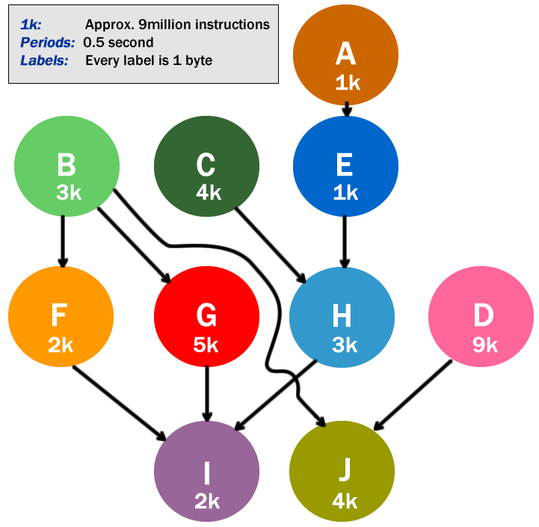
A4MCAR
Overall Look to A4MCAR
More Load..
Matrix
multiplication

Slide 15
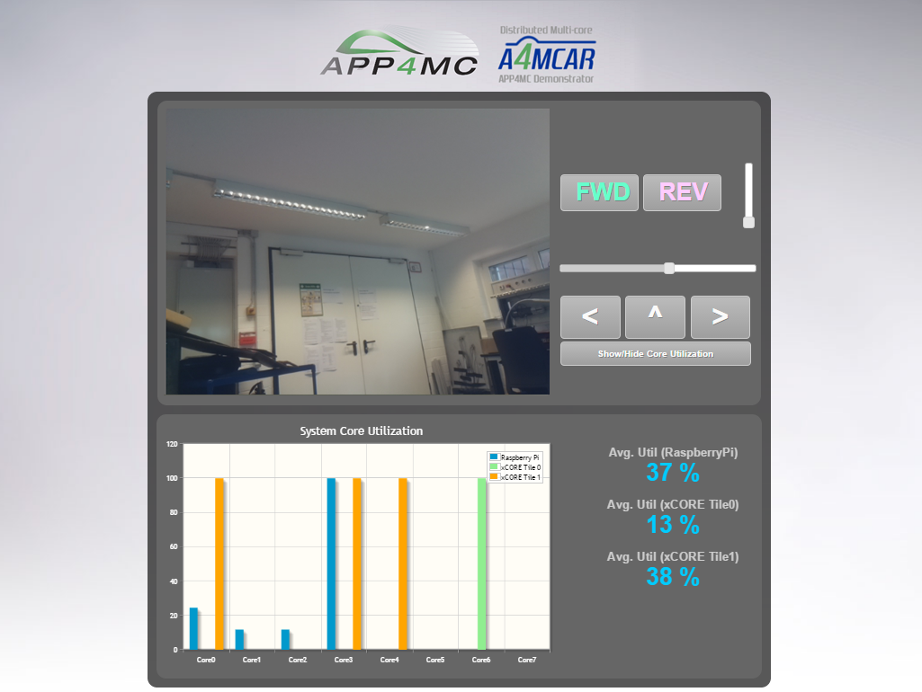
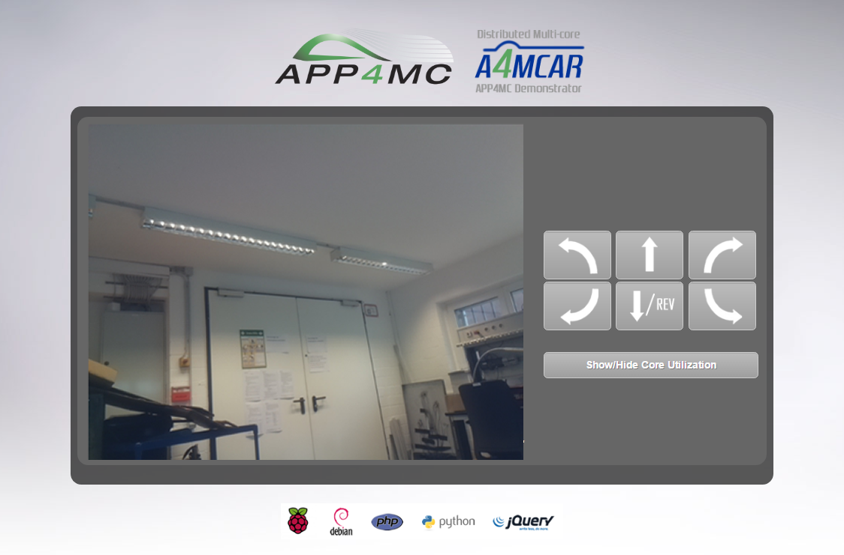
A4MCAR
Web Front-End

Slide 16
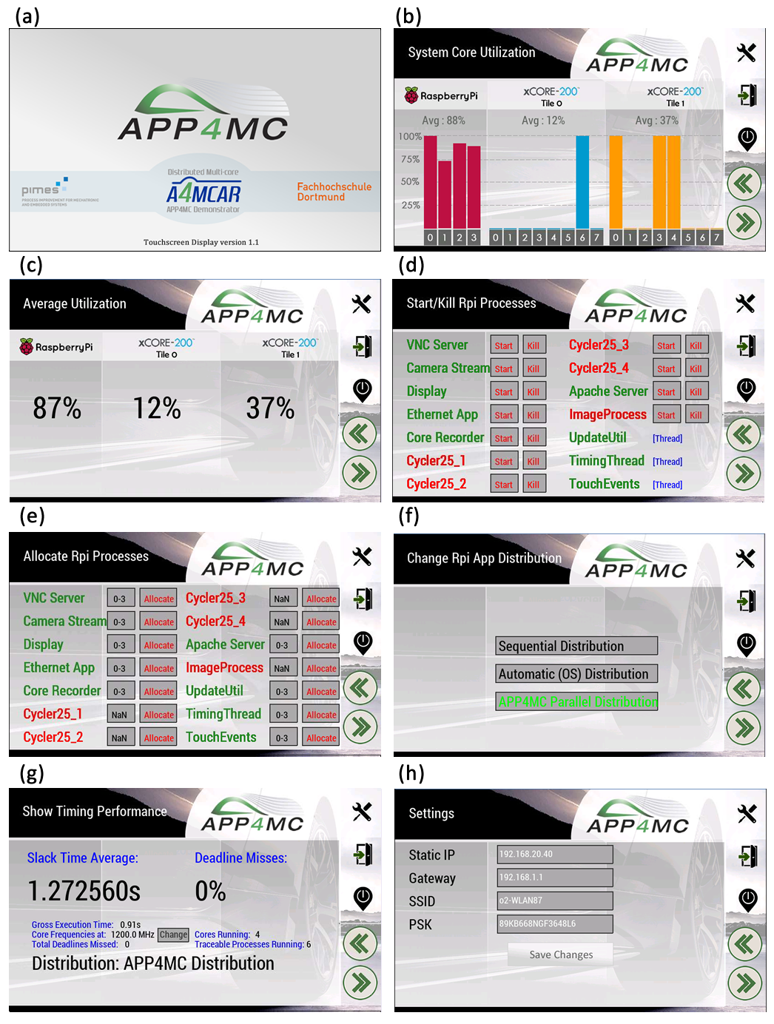
A4MCAR
Touchscreen
Front-End

Slide 17
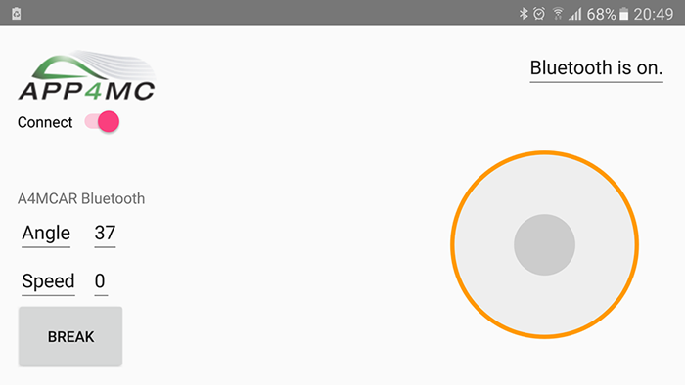
A4MCAR
Android
Front-End

Slide 18
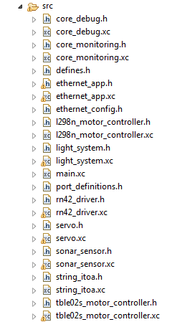
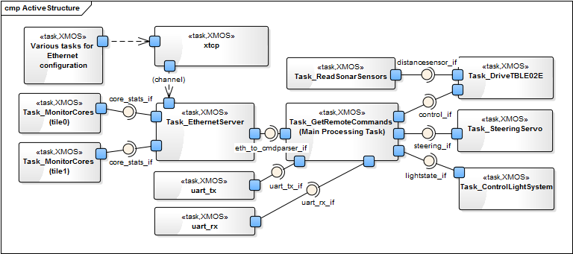
A4MCAR
Low-level Module Tasks
Overview

Slide 19
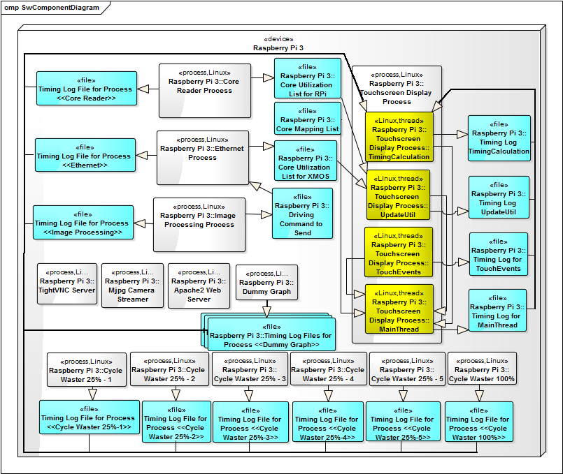
A4MCAR
High-level Module Tasks
Overview
ST, PER,
DL, GET
logged

Slide 20
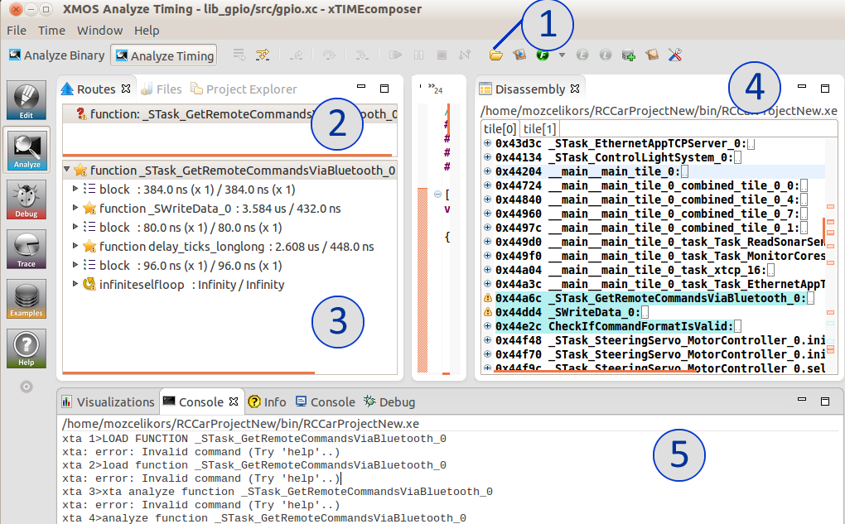
A4MCAR Tracing
Gathering Information to Model with AMALTHEA
What kind of Information Needed?
Instruction sizes of Runnables
Activation periods
Labels / label accesses
Tools Used & Configured
Low-level: XTA (xTIME Analyzer) for XMOS, Disassembly
High-level: perf stat

Slide 21
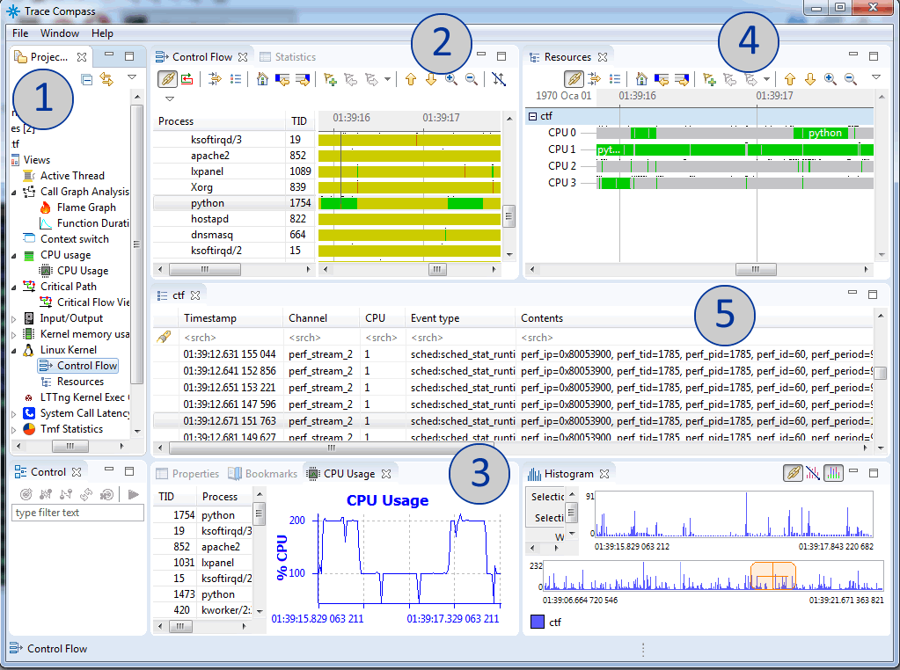
A4MCAR System Tracing
System tracing
Perf sched
Common Trace Format (CTF)
Eclipse TraceCompass

Slide 22
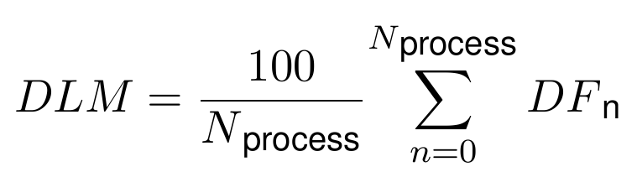
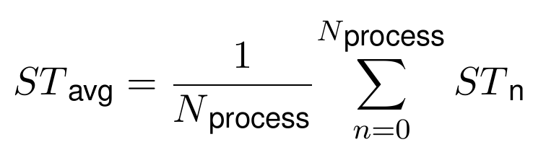
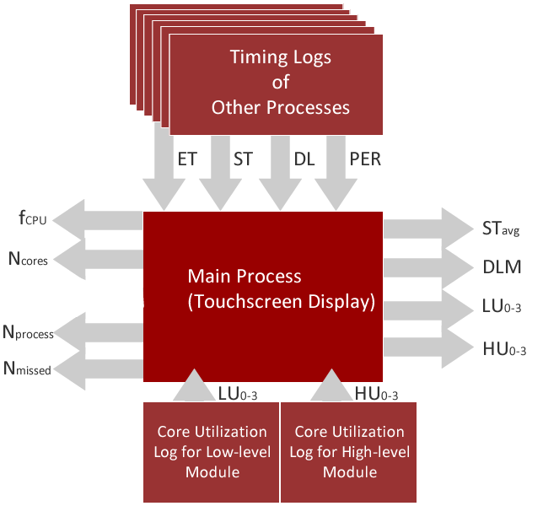
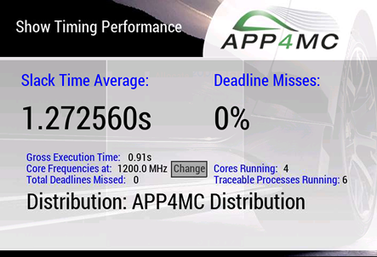
A4MCAR System Tracing
Implementations regarding evaluation metrics

Slide 23
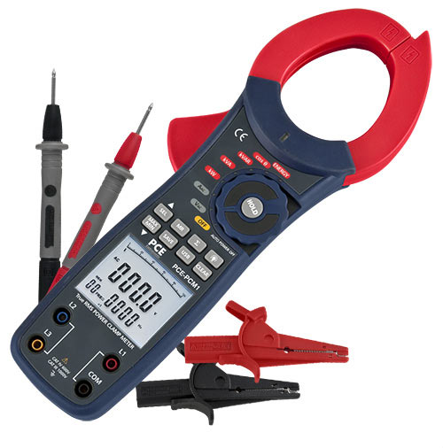
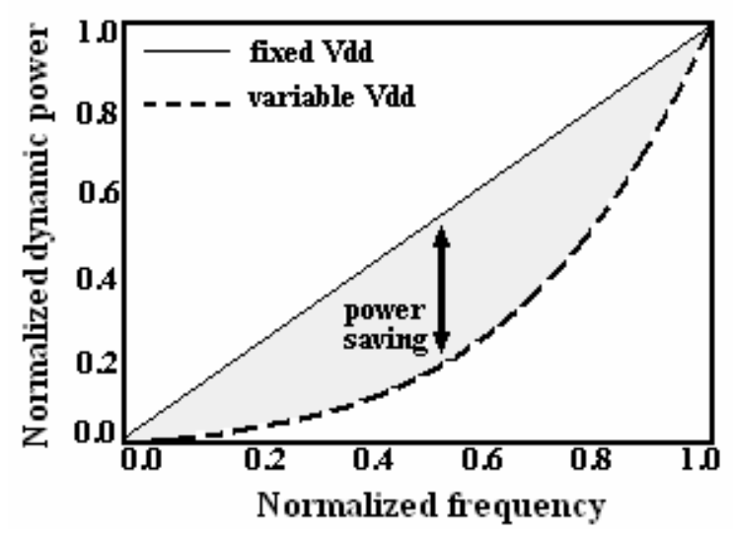
Reducing Power Consumption
We used a Clamp Meter
to measure current
Underclocking
cpufrequtils (in Linux)
core frequency registers (in XMOS)
Dynamic Voltage and Frequency Scaling (DVFS)
cpufrequtils
Active Energy Consumption (AEC) modes
halting a core when non-used
used

Slide 24
Modeling
Limitation
Non-exact model
Profiling errors and overheads (perf), System overheads (5%), Invisible OS elements
Sporadic activations are not allowed in APP4MC. Therefore, assumptions are involved.
Limitations and Constrains
Non-exact model
Profiling errors and overheads (perf), System overheads (5%), Invisible OS elements
Sporadic activations are not allowed in APP4MC. Therefore, assumptions are involved.
Strict dependencies in APP4MC’s Partitioning
OS does not ensure dependencies, while APP4MC ensures it.
More dependency-loose bin-packing algorithms are now being developed.
Static scheduling approach
APP4MC -> static scheduling approach, OS -> dynamic scheduling, migration involved
XMOS hardware and tooling limitations
Unresolvable sections of code.
Disassembly counting involved.
Core Utilization tracing using registers are only valid for periodic tasks, and are non-exact.
XMOS Application Functionality vs Transparency
Using third party libraries make it harder to have a traceable, distributable system.
Load-balancing limitations of APP4MC
Partitioning algorithms use activation-dependent grouping
Mapping algorithms focuses on reducing max. Computation time.
New approaches will consider n-stage algorithms to also consider load-balancing.

Slide 25
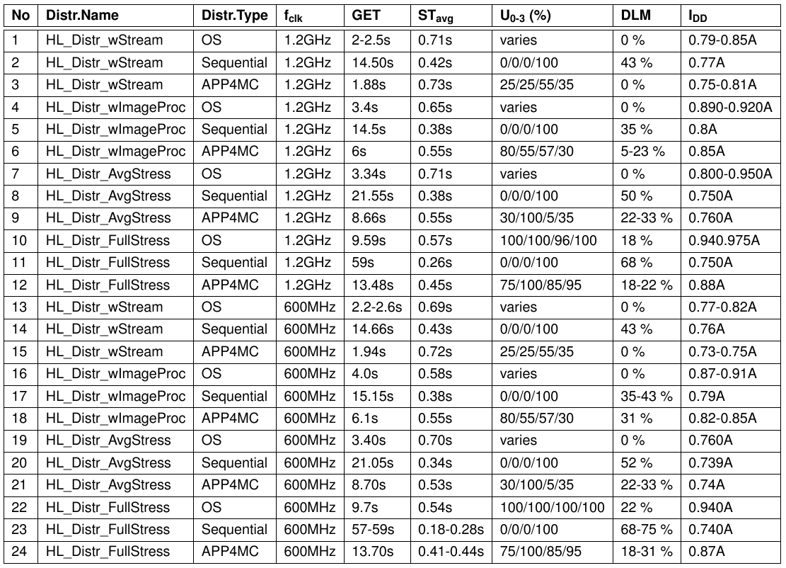
Results (Partitioning + Mapping)
HL Comparison &Evaluation
(ESSP, 10 partitions, GA)

Slide 26
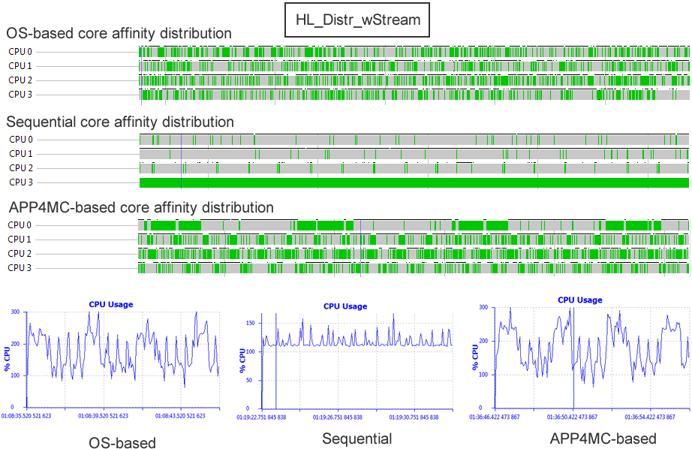
Results
Traces (from Eclipse TraceCompass)

Slide 27
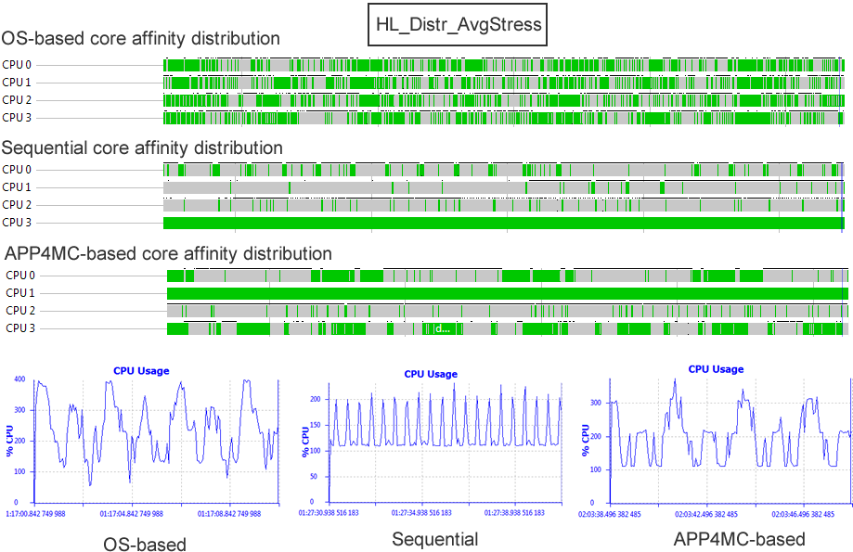
Results
Traces (from Eclipse TraceCompass)

Slide 28
Results
Evaluation Methodology
Evaluation Goal: To compare APP4MC with OS-based performance
Four distributions
Core-affinities are compared: OS, Sequential, APP4MC
Evaluation metrics involve: STavg, GET, DLM, U, IDD
Observed Results
In three distributions, timing performance OS > APP4MC > Sequential
In one distribution, APP4MC > OS > Sequential
So, achieving better performance with APP4MC is possible, but not guaranteed.
APP4MC results improve power cons. very slightly as opposed to OS.
Lesser context-switching in APP4MC.
OS-based distribution involves fluctiations in power consumption.
Power cons. (Underclocking + Downvoltage) > (Undercloking only)
Huge stability problems in Sequential distribution
Reasoning

Slide 29
Conclusions
Reasoning & Conclusion
A4MCAR has its limitations,
System overheads, profiling overheads, non-exact model, not-so fine-grained runnables.
APP4MC is real-time and ensures causal order.
CFS -> very fair, therefore non real-time.
Using RT patch (preemptRT) in Linux is a solution.
Also, OS does not ensure causal order.
APP4MC targets model-based development for industry applications.
Static scheduling is not the best way to approach Linux systems without low-level RTOS solns.
APP4MC targets more fine-grained, lower-level, higher-scale systems.
In our app, we use process/threads as runnables.
APP4MC’s partitioning only concerned about load-balancing when activation periods are the same.
APP4MC is in development stage,
Non dependency-dependent algorithms are being developed.
N-stage genetic algorithms are being studied for load balanding (as opposed to willy nilly distr.)
Not able to work when threads are sporadically activated.
APP4MC focuses on ideal vision of embedded computing
Automizing parallelization foundations based on model-driven manner, using static scheduling approaches.
To get rid of the non-determinism in parallelization, power consumption.
For more industry applications.
APP4MC is a suggestive, supplementary tool.

Slide 30
Thanks for Your Attention !

